Slide 1
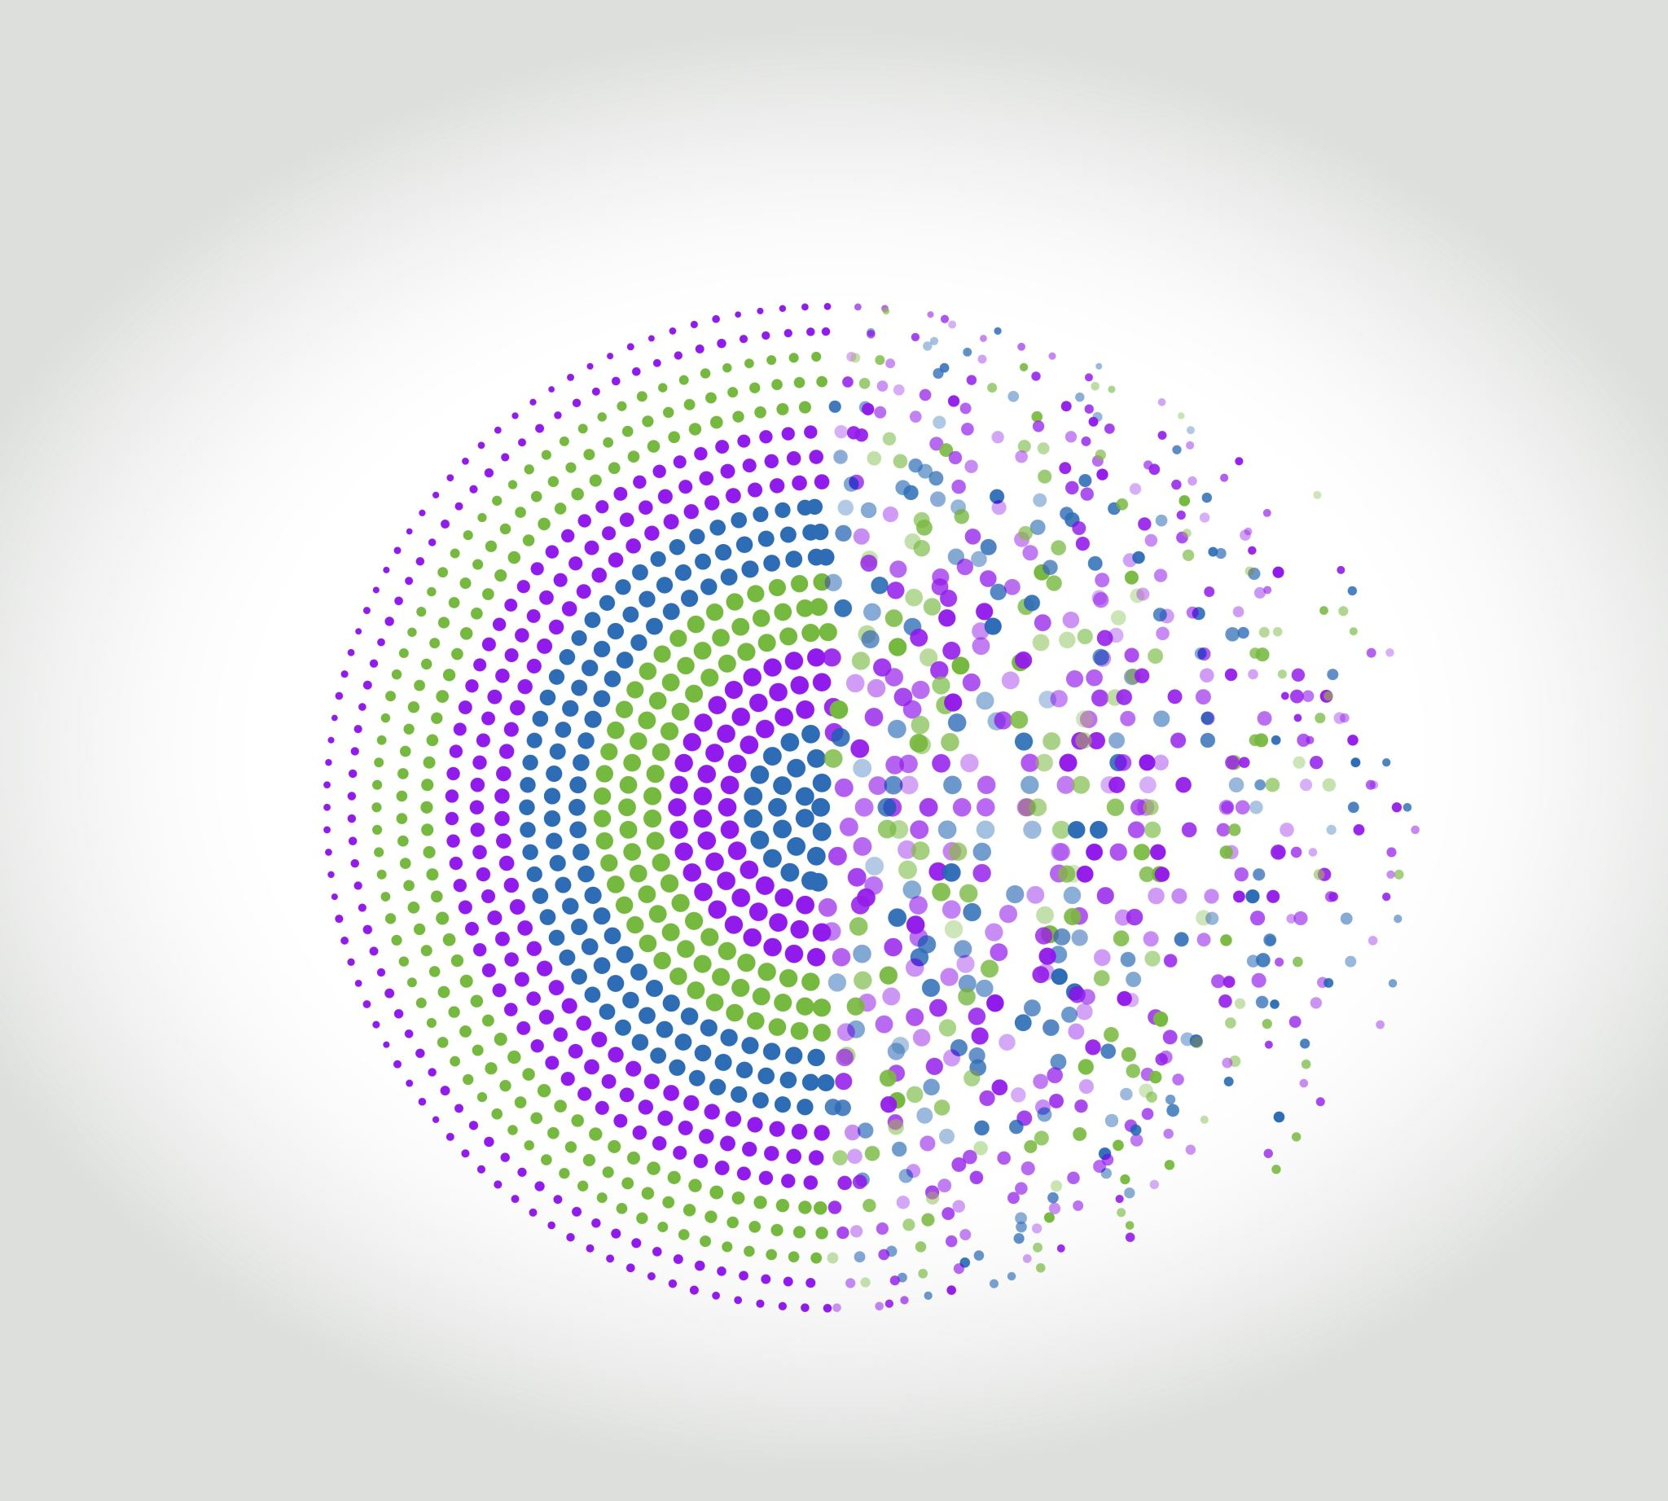
Institute of Data
Mini Project 3
Samantha Carlson
1 May 2021

Slide 2
Customer segmentation

Slide 3
Agenda
Background context
What is customer segmentation and RFM?
The Business Question
The data (including pipeline, EDA, cleaning)
The methods (Machine learning and manual)
The recommendation
Limitations
Questions

Slide 4
Should an organisation find new customers or should it focus on existing customers?

Slide 5
Customer retention vs acquisition
Acquiring a new customer can cost five times more than retaining an existing customer.
The success rate of selling to a customer you already have is 60-70%, while the success rate of selling to a new customer is 5-20%.

Slide 6
Customer retention
The holy grail of marketing = ‘WORD OF MOUTH’
→ CUSTOMER RETENTION → ACQUIRES NEW CUSTOMERS.

Slide 7
What is customer segmentation and RFM?
Customer segmentation is the division of customers into discrete groups.
RFM is a method to measure customer value based on three factors:
How recently have they shopped with us?
How frequently do they shop with us?
How much money do they spend?
Recency
Monetary
Frequency

Slide 8

Example of RFM
A retail store’s ideal customer would have:
Low recency (they only shopped yesterday)
High frequency (they shop often)
High monetary (they spend a lot)

Slide 9
Business Question
A retail company has hired my services to determine:
“On which customer segment should we focus our marketing resources and activities?”

Slide 10
Pipeline
Data acquisition
Cleaning and EDA
Feature engineering
Customer cohort analysis
RFM segmentation (Kmeans)
RFM segmentation (Manual)

Slide 11

The Data
From a UK online-only retail store
2 x data sets totally 1,067,371 observations from two years of sales
2009-10 - 525,461 observations
2010-2011 – 541,910 observations
https://archive.ics.uci.edu/ml/datasets/Online+Retail+II

Slide 12

Cleaning
Removal of:
34,335 duplicate values
235,151 rows where customer ID was missing
Removal of 7,331 cancelled orders
3,564 rows where the charges were internal to the store (e.g. post, bank charges, etc.)

Slide 13
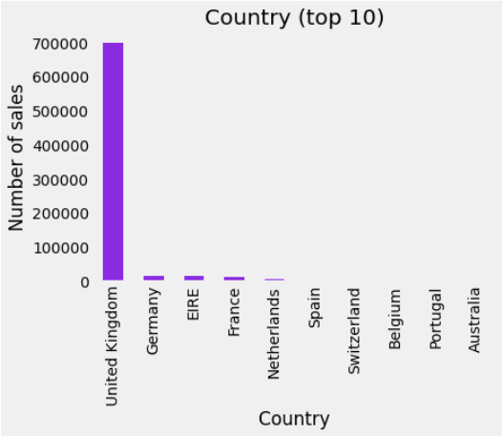
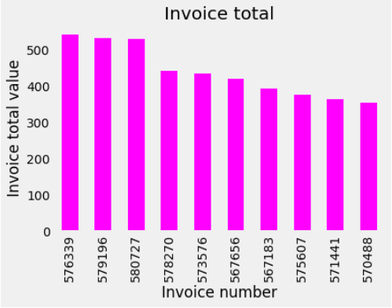
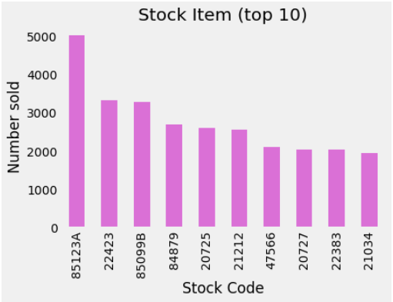
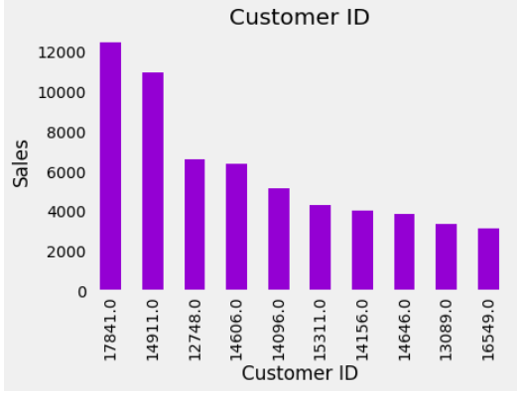
EDA – Top 10

Slide 14
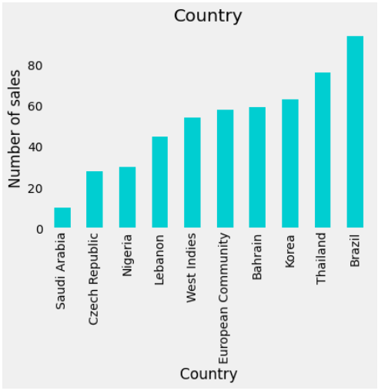
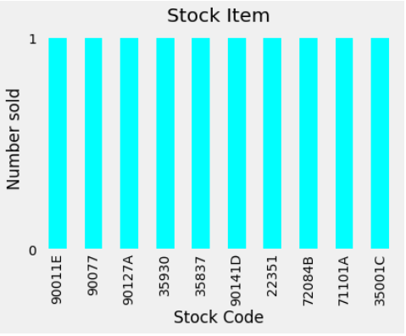
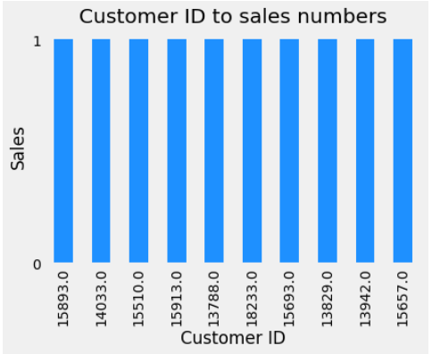
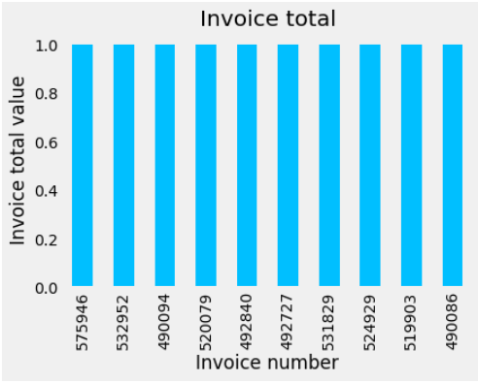
EDA – Bottom 10

Slide 15
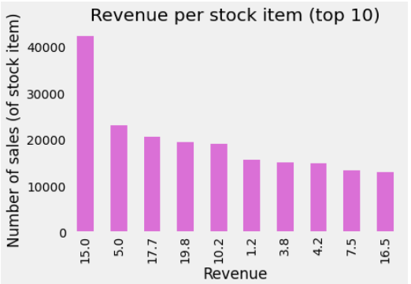
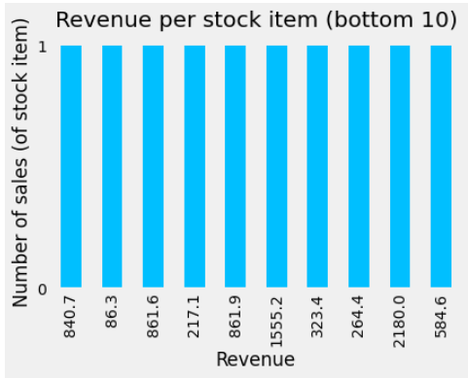
Feature engineering
Creation of ‘Revenue’ column
Total price of sale (stock price x quantity sold) → per item

Slide 16
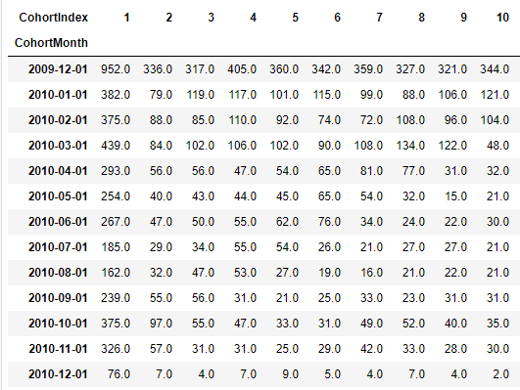
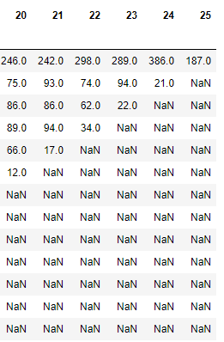
Cohort analysis & monthly active users

Slide 17
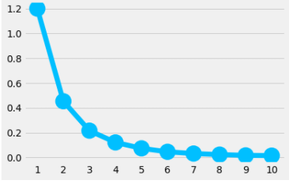
RFM Segmentation - Kmeans
Using the revenue, cohort analysis and monthly active users, I used Kmeans to determine the optimal cluster number.
The Elbow method:

Slide 18
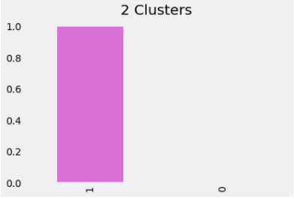
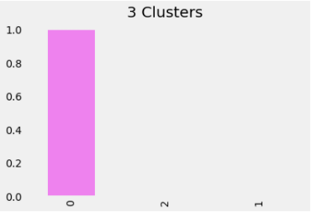
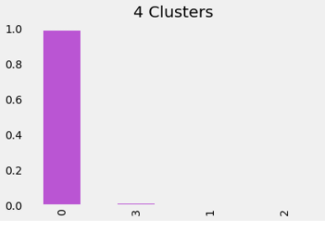
2, 3, 4 Clusters (Kmeans)

Slide 19

Silhouette analysis
The closer to ‘1’ the better

Slide 20
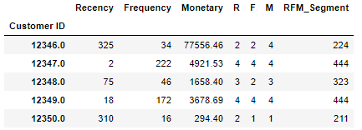
RFM Segmentation – Manual process
Step 1
Step 2
Step 3

Slide 21
However,
I now have 60 different segments that a customer could belong to:
111, 112, 113, 114, 121, 122, 123, 124……………444
So,
I added up the three numbers to come up with a score for each customer
111 = 3
…
444 = 12

Slide 22
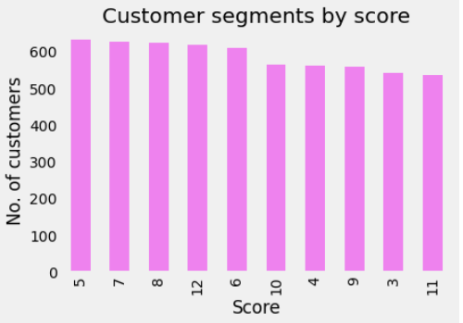
Customer score segments

Slide 23
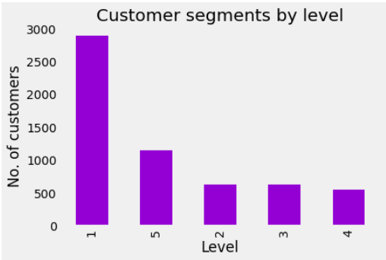
Segment grouping
Grouping segments by two scores:
Scores 12 and 11 = Champions
Scores 10 and 9 = Loyal
Scores 8 and 7 = Good
Scores 6 and 5 = Occasional
Scores 4 and 3 = Might Lose

Slide 24
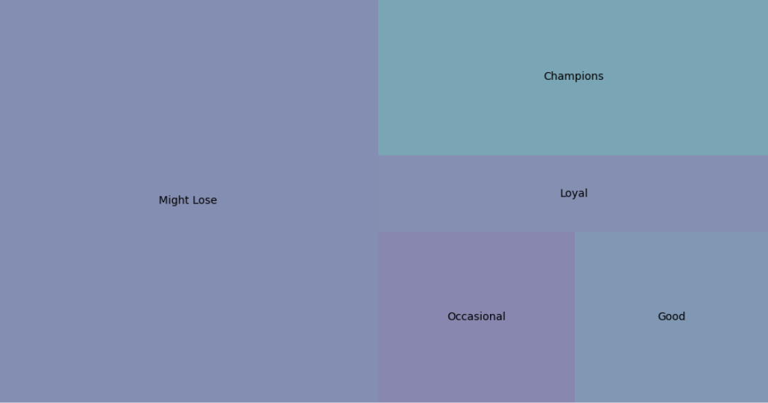
30%
60%
10%

Slide 25
Recommendation
“On which customer segment should we focus our marketing resources and activities?”
1. To increase the number of sales and profit, I would suggest focussing marketing resources and activities on those customers in groups 1 and 2 (‘Might Lose’ & ‘Occasional’).
2. If you could bring the monetary value of customers in these groups to the average value of those customers in groups 4 and 5, you could make an additional $14,008,034 per year.

Slide 26

Additional recommendations
3. Show appreciation for your group 4 & 5 customers:
VIP program
Including VIP discounts and early access to sales items
Point accrual for every dollar spent
Referral rewards.
4. Targeted approach and ongoing review of customers that fall into the middle category (3) and timed sales/VIP events to incentivise them to return.
Essentially move these ‘on-the-fence’ customers into a higher category.

Slide 27
Limitations
This data is strongly skewed with a high number of customers in group 1 (‘might lose’).
Tring to predict human behaviour
Small data set, while it has over 1m observations, this only accounts for ~5800 customers due to repeat business.
No information about current marketing incentives in place and the associated costs and returns.

Slide 28
Questions?

Slide 29
References
https://www.owox.com/blog/use-cases/rfm-analysis/
https://www.eightleaves.com/2011/01/using-rfm-to-identify-your-best-customers
https://www.outboundengine.com/blog/customer-retention-marketing-vs-customer-acquisition-marketing/
https://www.kaggle.com/fszlnwr/customer-segmentation-rfm-cohort-analysis
https://campus.datacamp.com/courses/customer-segmentation-in-python/cohort-analysis?ex=3
https://www.marsja.se/transform-skewed-data-using-square-root-log-box-cox-methods-in-python/
https://towardsdatascience.com/recency-frequency-monetary-model-with-python-and-how-sephora-uses-it-to-optimize-their-google-d6a0707c5f17
https://medium.com/analytics-vidhya/how-to-determine-the-optimal-k-for-k-means-708505d204eb

